Slide 1
Seminar 2

Slide 2
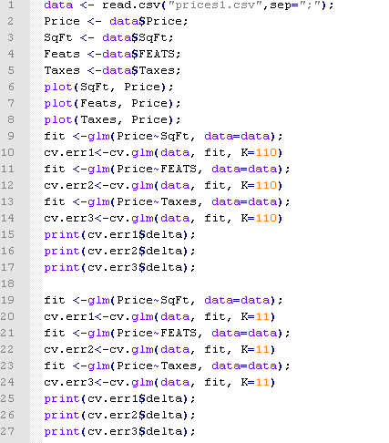
Lab 4: Assignment 1

Slide 3
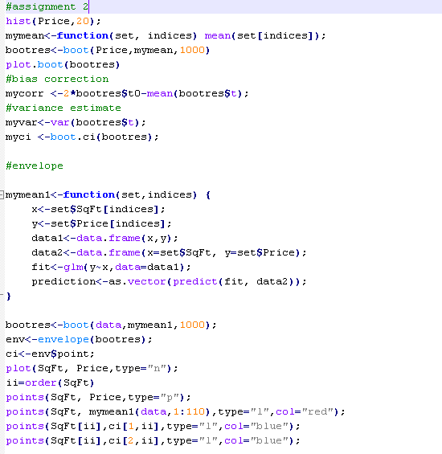
Lab 4: Assignment 2

Slide 4
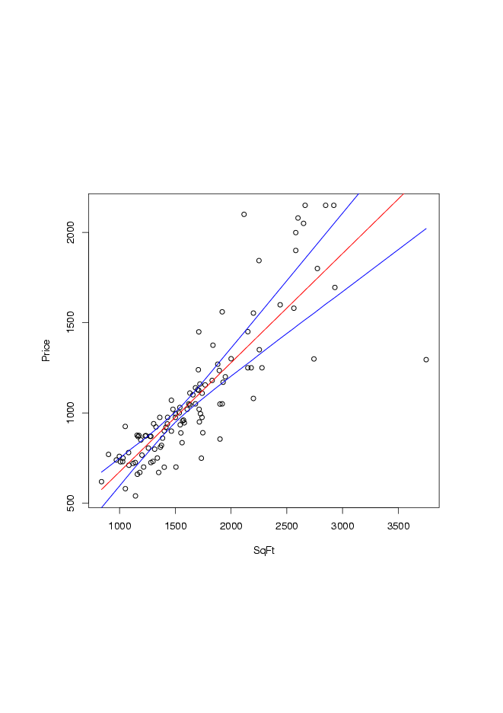
Lab 4: Plot

Slide 5
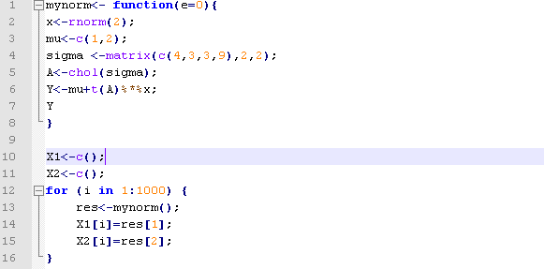
Lab 5

Slide 6
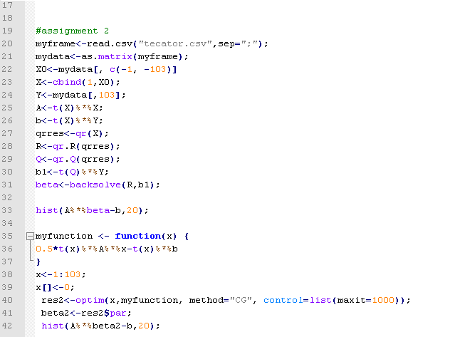
Lab 5

